Slide 1
The Role of Cloud Computing in Modern Business
Name : 25K-0610 – Muhammad Siddique
Course : BCS
Section : 1C

Slide 2
Content
Introduction to Cloud Computing
Benefits of Cloud Computing
Cloud Computing Services
Security Concerns in Cloud Computing
Future of Cloud Computing
Conclusion

Slide 3

What Is Cloud Computing?
Think of cloud computing like using Netflix or Spotify.
Instead of owning a massive collection of DVDs or CDs that take up space in your house, you just stream what you want over the internet. The movies and music don't live on your device; they live on a powerful, remote system (the "cloud"), and you just access them when you need them.

Slide 4
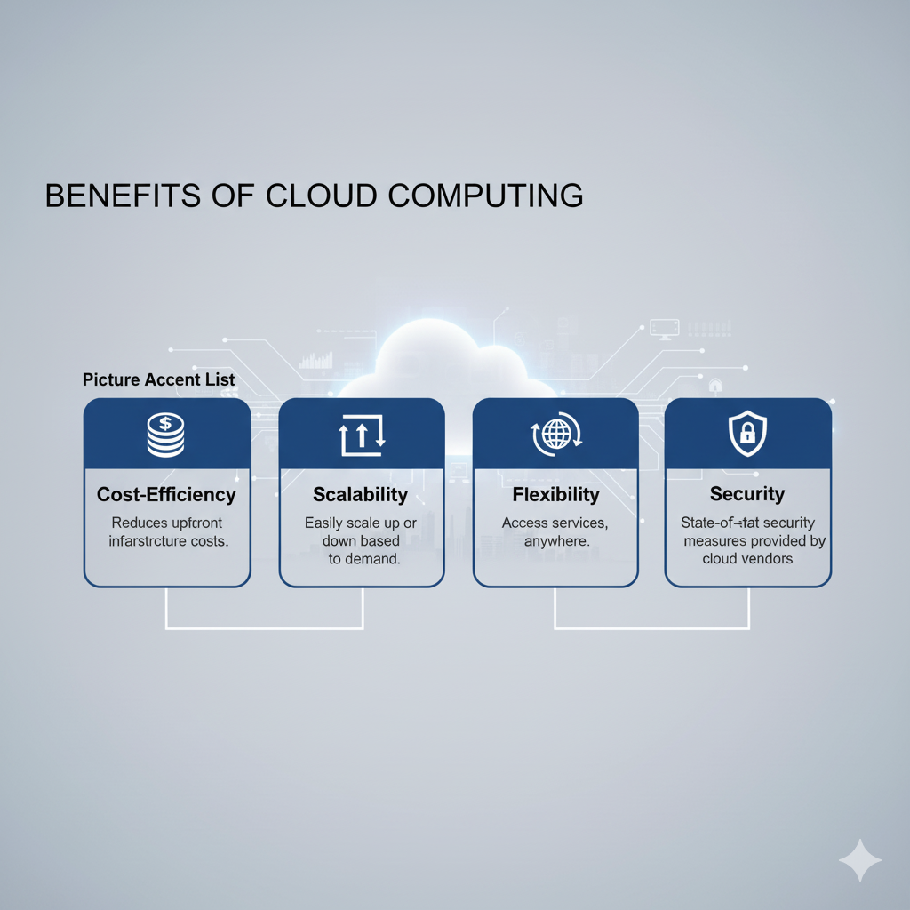
Benefits OF Cloud Computing
Cost Efficiency
Scalability
Flexibility
Security

Slide 5
Types OF Cloud Computing
CLOUD COMPUTING
IaaS
Paas
Saas
IaaS ( Infrastructure as a Service )
PaaS ( Platform as a Service )
SaaS ( Software as a Service )

Slide 6
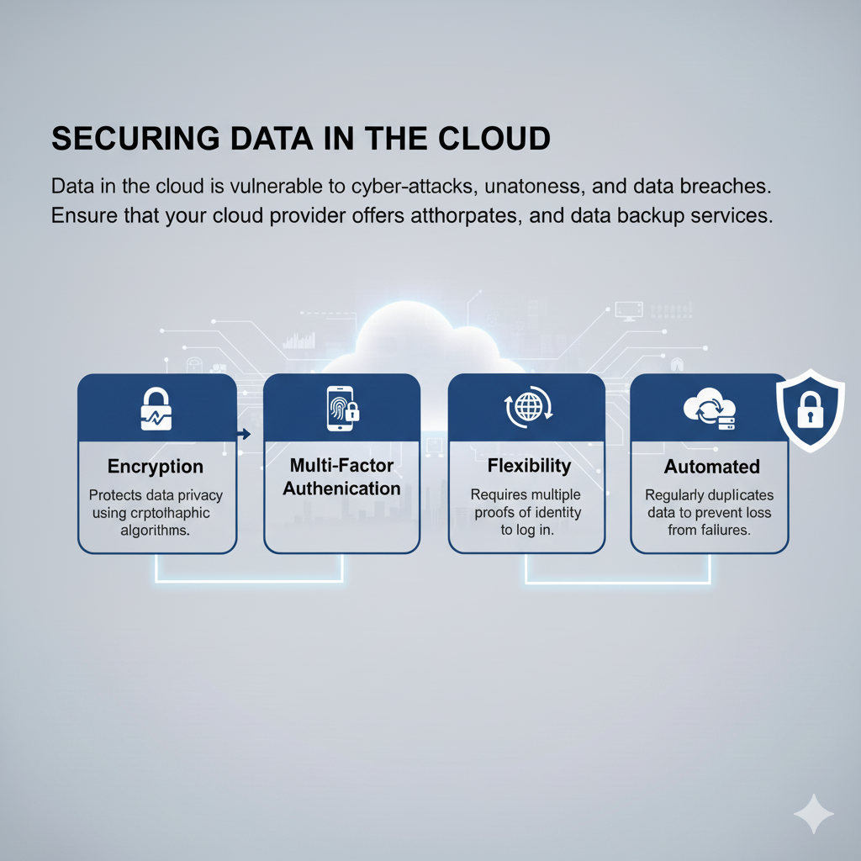
Security OF Cloud Computing
Data in the cloud computing is often risky because of the cyber attacks, unauthorized access and data breaches.
There are also some ways to stay safe from these things, which are encryption, multifactor authentication and data backup services.

Slide 7
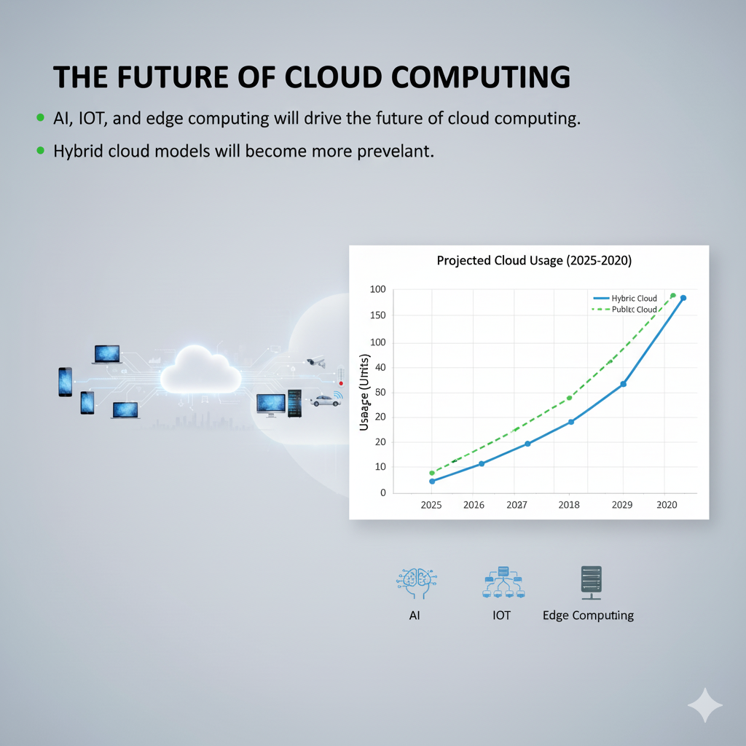
The Future OF Cloud Computing
AI, IOT and Edge Computing will be giving future to Cloud Computing in a way that will be not too expensive.
As AI and machine learning mature, they are becoming increasingly integrated into cloud platforms to offer more intuitive and autonomous services. This "humanized AI" moves beyond basic automation to power intelligent applications that are more efficient and responsive to users' needs.

Slide 8
The Future OF Cloud Computing
The massive volume of data produced by the growing number of IoT devices requires a new approach to processing. Edge computing moves data processing and storage closer to the source of the data, extending the cloud to the network's edge.
The hybrid cloud provides the balanced, flexible infrastructure that orchestrates workloads between the edge and the core cloud.

Slide 9

Conclusion
Think of cloud computing as your company's digital toolbox. It's a game-changer because it helps you save money by only paying for what you need, it's flexible enough to grow with you, and it keeps everything locked up tight. Looking ahead, with all the exciting new developments in AI and the Internet of Things, the cloud will be an even bigger, more powerful tool in every company's kit.

Slide 10

Thank You
THE END.

